Slide 1
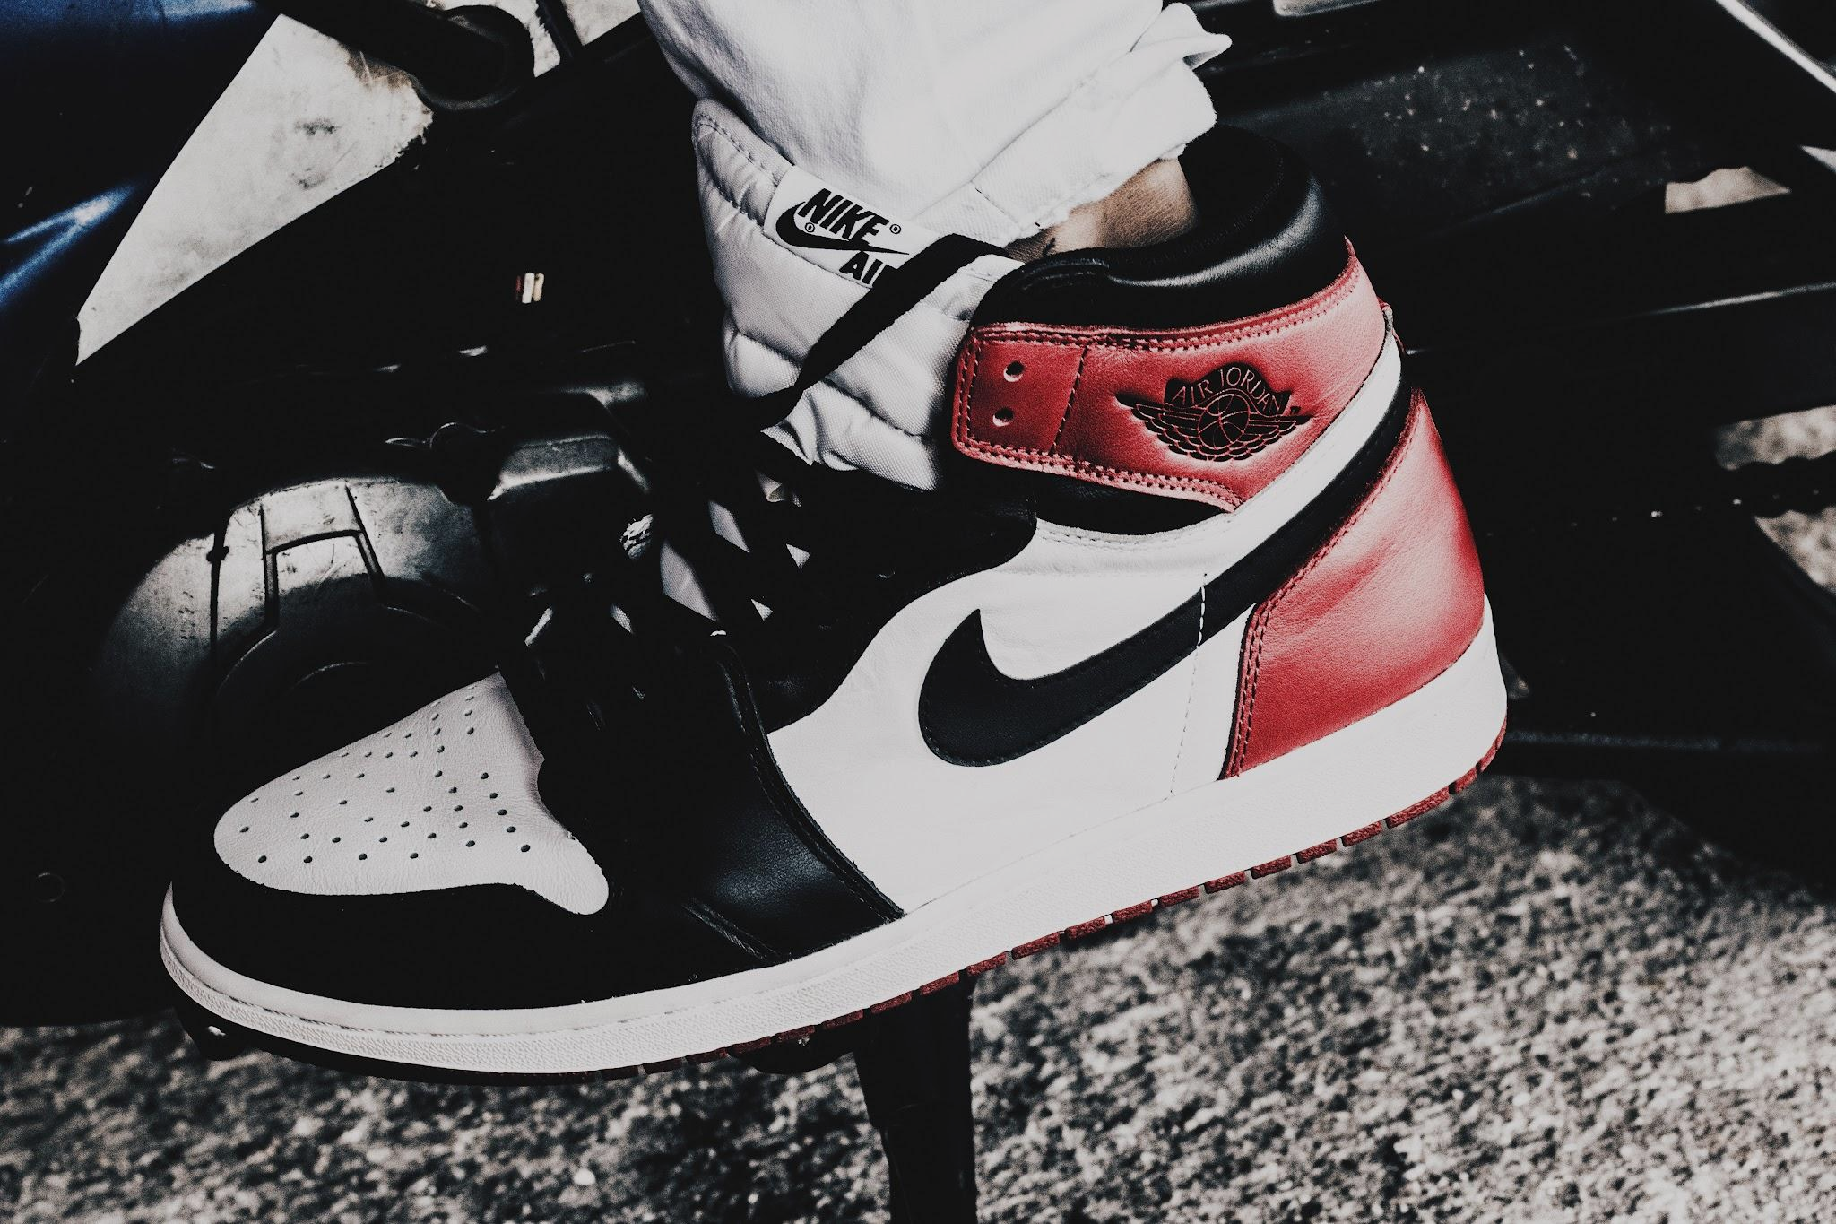
Nike:
Product Recommendation System
Karan Khadka, 0836689
Data Analytics in Business
11-26-2024

Slide 2
Introduction and Marketing Objective
Industry Chosen
Marketing Problem
Solution and benefits
Nike, a leading global sportswear brand. Nike continually seeks to enhance customer engagement and satisfaction through innovative products and effective marketing strategies.
Analysing how factors like product pricing, comfort feedback, etc. impacts satisfaction.
Finding a solution as to how this analysis can be used to increase sales.
By addressing the factors and building a recommendation system to ensure relevant product suggestions.
As e-commerce continues to grow, effective product recommendations are essential for improving customer experience and increasing sales.

Slide 3
Data Overview
Data Information
Statistical Summaries
Before Data Cleaning:
4587 rows
20 columns
6 Numerical columns and 14 categorical columns.
After Data Cleaning:
1245 rows
19 columns
No missing or null values
Average fullPrice = ~ 110
Average currentPrice= ~ 105
Average employeePrice = ~ 63
Average Rating = 4.76
Average Feedback score = 4.43/5

Slide 4
Exploratory Data Analysis

Slide 5
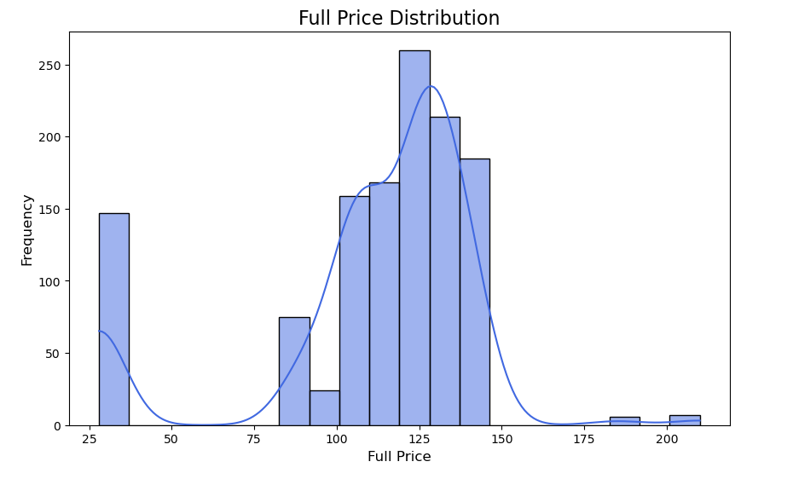
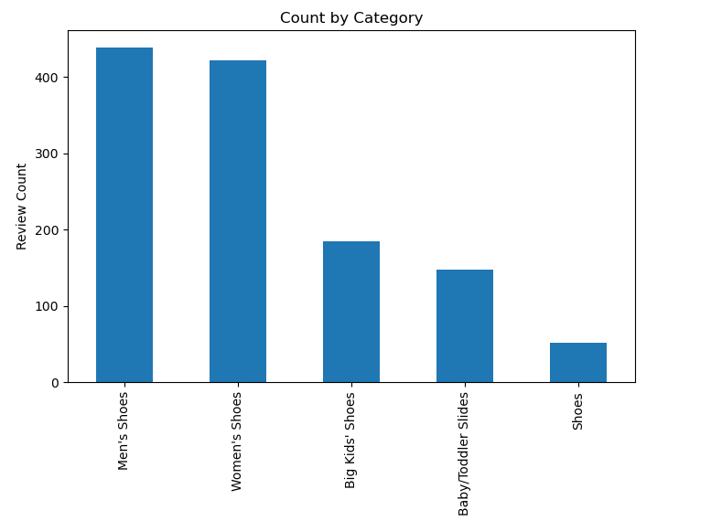
Univariate Analysis
Full Price Distribution:
We can see that most of the products that have been bought are clustered in the center with a slight skew on the right as there products bought in the low range too.
Category Distribution :
The two most category of shoes bought are Men’s shoes and Women’s shoes followed by Big Kid’s.

Slide 6
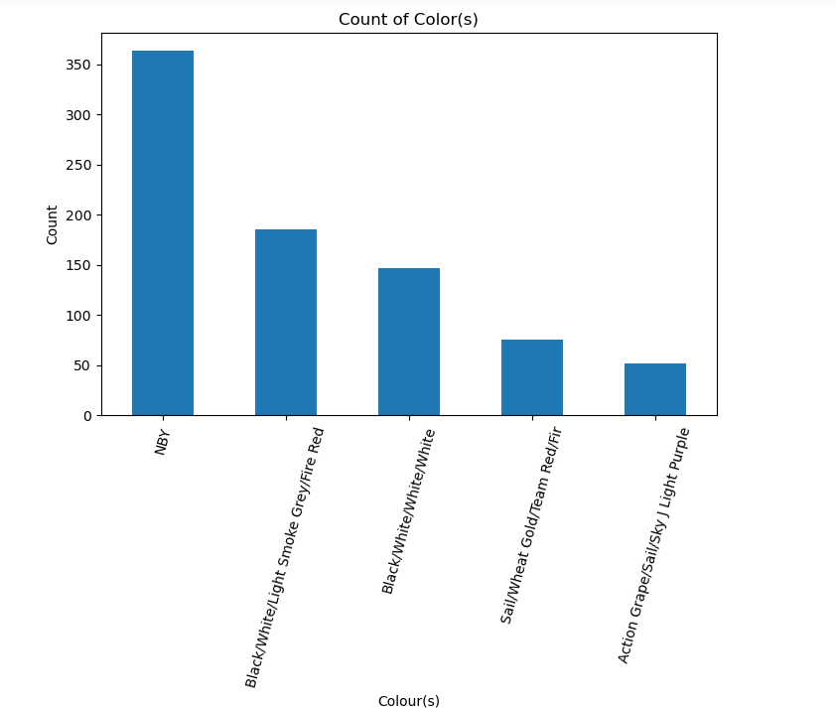
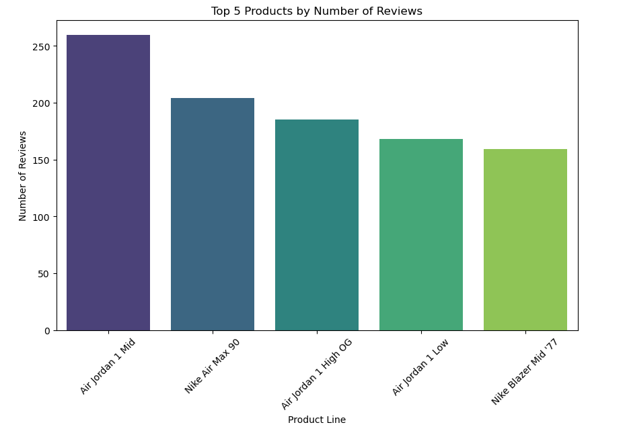
Highest number of reviews/purchases
Top 5 Color(s) : The most popular color is NBY that is ‘Nike By You’ where customers can select their own combination of colors. This is followed by ‘Black/White/Smoke Grey/Fire Red’ which is the second most popular color.
Top 5 Products : ‘Nike Air Jordan 1 Mid’, is the most popular pair of shoes with over 250 reviews followed ‘Nike Air Max 90’

Slide 7
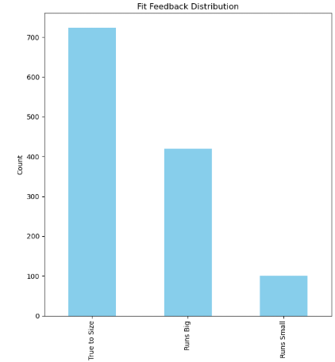
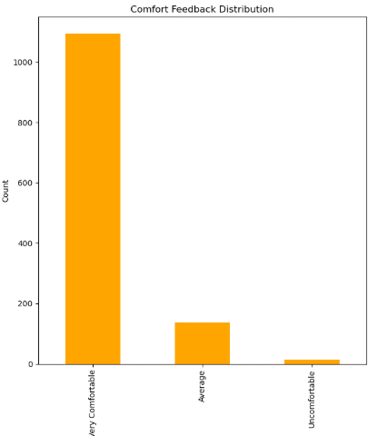
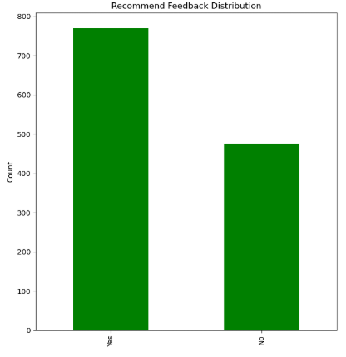
Feedback Analysis
Fit Feedback: Most of the shoes are True to size, but the number of shoes which Runs Big or Runs Small is still significantly high.
Comfort Feedback : Almost all the shoes are Very Comfortable with less than 200 shoes with average and uncomfortable feedback.
Recommend Feedback : Even though the number of positive recommend feedback is more than negative, the number of ‘No’ for recommending the product is still high.
This could be, because of the size issues as there are significant shoes with size issues or it could even be the price.

Slide 8
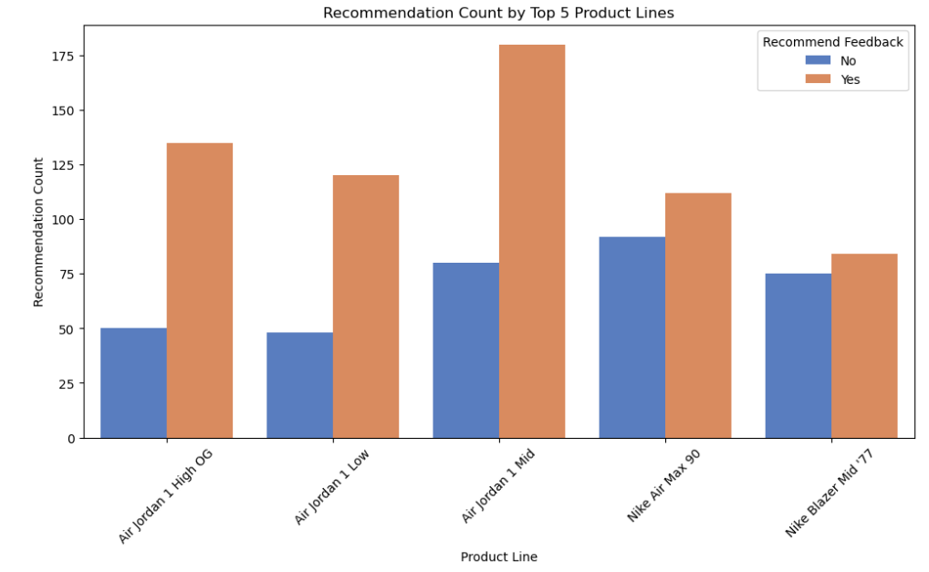
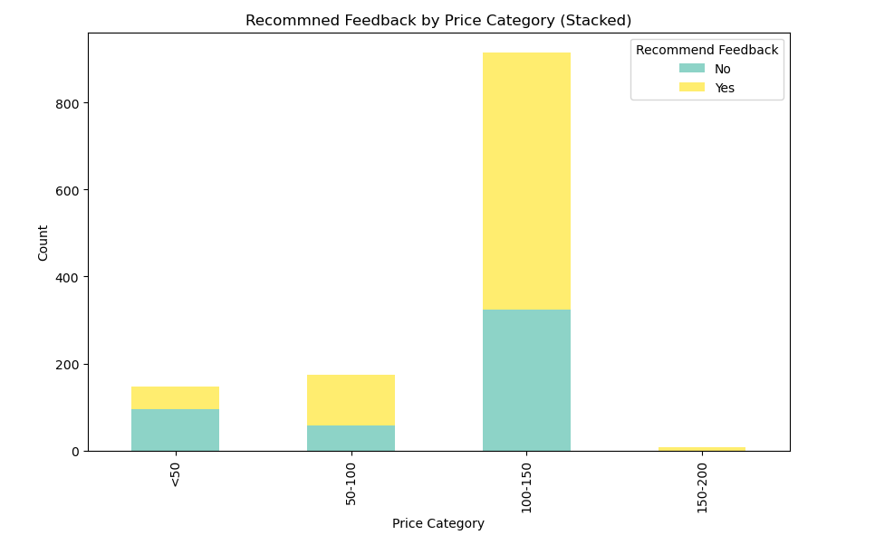
Bivariate Analysis
Recommendation Count for Top 5 Product: The most popular pair of shoes ‘Nike Air Jordan Mid’ also has the highest positive recommendation feedback. Even though ‘Nike Air Jordan 1 OG’ is ranked below ‘Nike Air Max 90’ in popularity, it has higher positive recommendation feedback.
Recommendation Count by Price Category : We can see that shoes in the 100-150 price category has the most number of feedbacks. We can see as the price increases the proportion for negative recommendation feedback goes down. Cheaper shoes have higher negative feedback count.

Slide 9
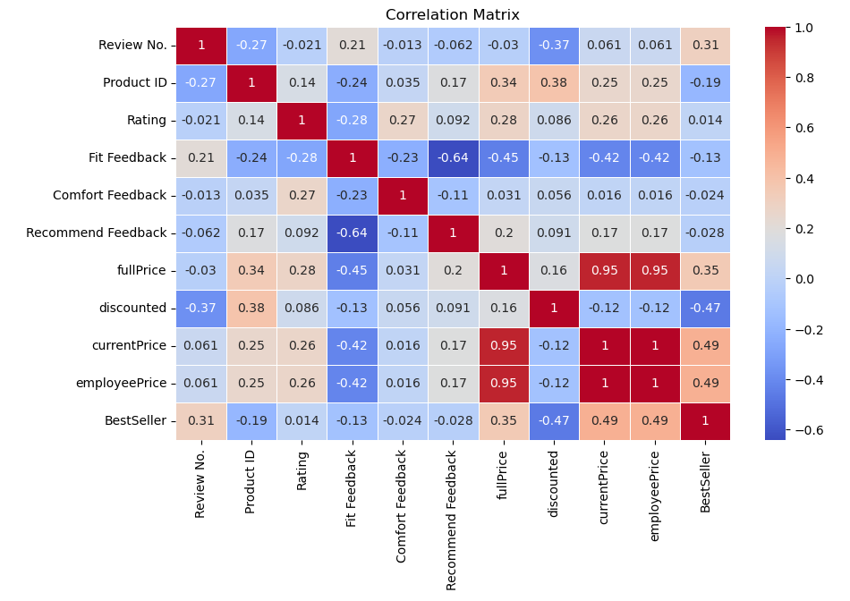
Multivariate Analysis
Moderate negative correlation between ‘discounted’ and ‘BestSeller’ (-0.47) which means Best-selling products are less likely to be discounted.
‘BestSeller’ has a moderate positive correlation with ‘currentPrice’ (0.49) inferring higher-priced products might also be best sellers.
‘Fit Feedback’ and ‘Recommend Feedback’ have a strong negative correlation (-0.64).which could mean who feel the fit of a product is poor are less likely to recommend it.

Slide 10
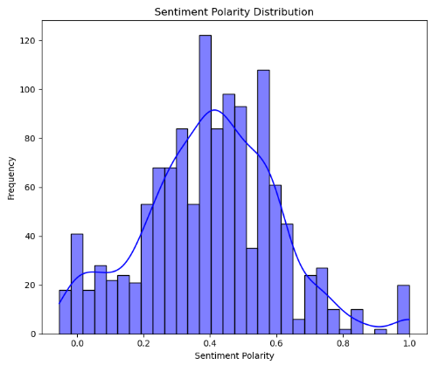
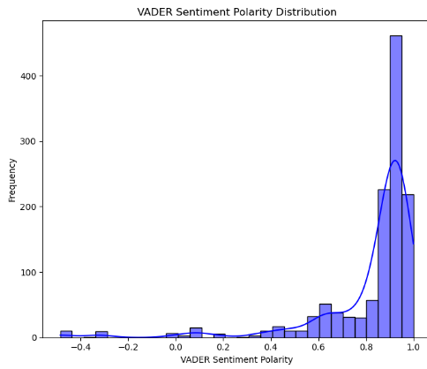
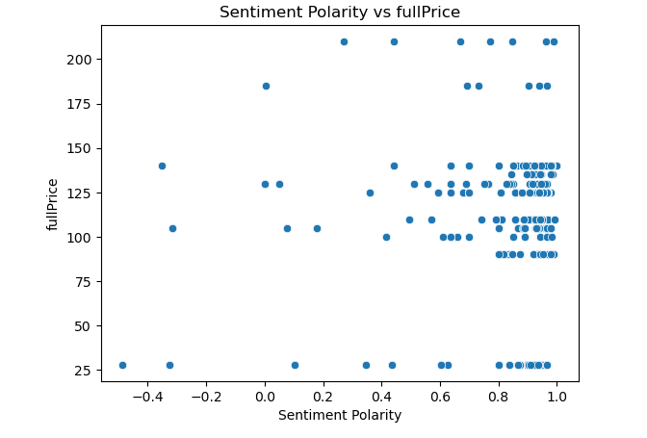
Sentiment Analysis
The sentiment scores seem to be normally distributed with a peak around 0.4–0.6, indicating that the dataset contains predominantly neutral-to-positive sentiments.
The tails suggests fewer instances of very negative or very positive sentiments.
The VADER sentiment polarity distribution is heavily skewed towards the positive range (0.8–1.0).
Products with negative sentiment (polarity below 0) appear to have prices mostly below $125.
Higher sentiment values (above 0.5) are associated with a broader range of prices, including higher-priced products ($150+).

Slide 11
Product Recommendation System

Slide 12
Steps to make Product Recommendation System
The features I am choosing
are:
['currentPrice','fullPrice', 'Rating',
'Comfort Feedback',
'BestSeller',
'Fit Feedback',
Category,
'Color(s)',
'Sentiment_Polarity','
VADER_Sentiment']
First we select the method we are going to use. I am using Content based filtering for my model as I have less user-interaction data and more features on the content.
I am using cosine symmetry for my model to make predictions.
For each product select the model recommends at most 10 products similar to the one chosen.

Slide 13
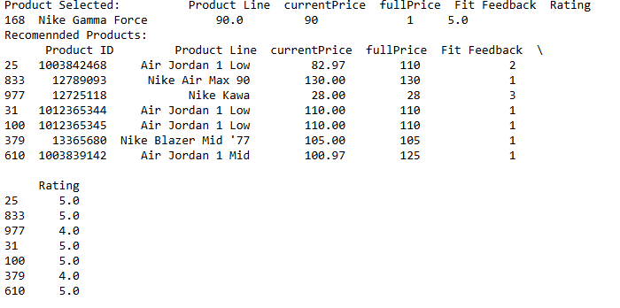
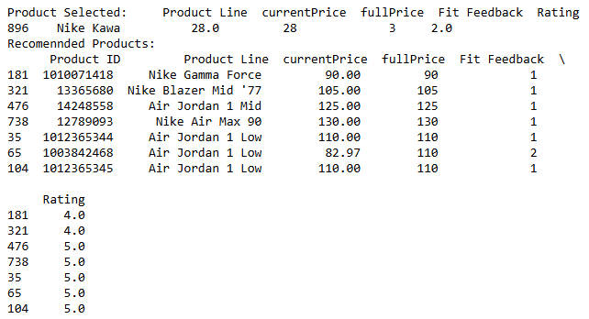
Results
We first select a product. Based on our selection, the model gives at most 10 recommendations.
Each time you select a new product, new recommendations are given.
The recommendations are based on the currentPrice, FitFeedback, Rating, etc.
The precision score for the model is low, Precision@10 = 0.20 indicating on average, only 20% of the top 10 recommendations are relevant.
The Mean Reciprocal Rank is also low, MRR = 0.50 indicating that the first relevant item appears at rank 2

Slide 14
The sentiment and recommendation analysis revealed critical insights into product performance and customer preferences like ‘Nike Air Jordan Mid ’ is the most popular pair of shoes and how customers like it when they can customise their shoes like in ‘NBY’.
A content-based filtering recommendation system was implemented, leveraging product attributes like price, ratings, and feedback to suggest similar items.
While functional, the recommendation system's effectiveness is limited, as indicated by its low Precision@10 (20%) and Mean Reciprocal Rank (0.50).
A better dataset with less repeatability and with more user interaction data can produce a better model.
Conclusion

